Slide 1
Machine Learning
Unit – 4 – [Part 1]
Decision Tree

Slide 2
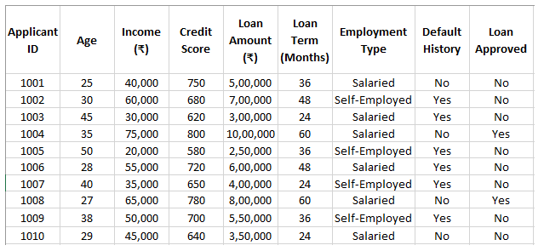
Decision Tree
Understanding the Dataset: Our aim is to predict whether a person deserves to get a loan approved or not. The "Loan Approved" column is our target variable, which has two categories: "Yes" and "No". Since the target variable is categorical, this is a classification problem, not regression.
Dataset Analysis:
This dataset consists of both categorical and numerical values, making it a mixed dataset.
Categorical Columns: Employment Type (Salaried / Self-Employed), Default History (Yes / No), Loan Approved (Yes / No).
Numerical Columns:Age, Income (₹), Credit Score, Loan Amount (₹), Loan Term (Months)

Slide 3
Suitable Classification Algorithms:
Since this is a classification problem (predicting "Yes" or "No"), we can use multiple classification algorithms like:
Decision Tree, Logistic Regression, Naïve Bayes, Random Forest, Support Vector Machine (SVM).
The main point is:
The dataset has both numbers and categories – Decision Trees handle both types well.
For example, this dataset has:
Categories: Employment Type (Salaried/Self-Employed), Default History (Yes/No)
Numbers: Age, Income, Credit Score, Loan Amount
We can easily create rules just by looking at the data – Decision Trees are great when we can break down the decision step by step. For example:
If Credit Score >= 680 and Income >= 50,000, approve the loan.
If Credit Score < 680 and Default History = Yes, reject the loan.
Decision Trees are best when data patterns are clear and rule-based, and the dataset contains both numbers and categories – If we can make logical decisions by just observing the data, a Decision Tree is a good choice.

Slide 4
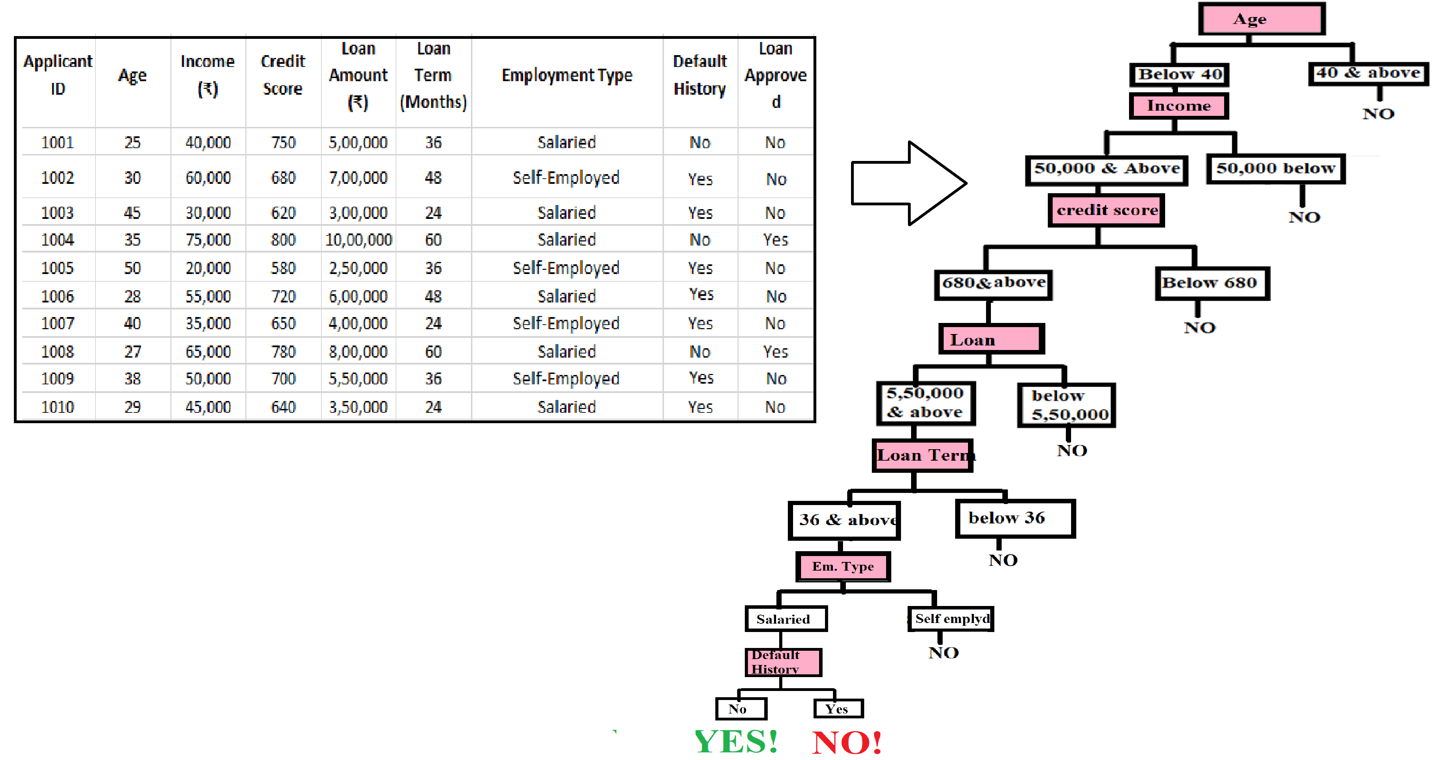
We can convert this dataset into decision tree:-
Instead of manually creating rules, we can use a Decision Tree Algorithm that will automatically generate a tree structure with parent nodes and child nodes, just like in the given diagram.
How does this work?
1. The algorithm splits the dataset based on the most important feature first (e.g., Age in the diagram). 2. Each split creates child nodes, further dividing the data into smaller groups. 3. The process continues until a stopping condition is met (e.g., pure leaf nodes or max depth). 4. The final tree provides clear decision paths, which we can use to make loan approval predictions.

Slide 5
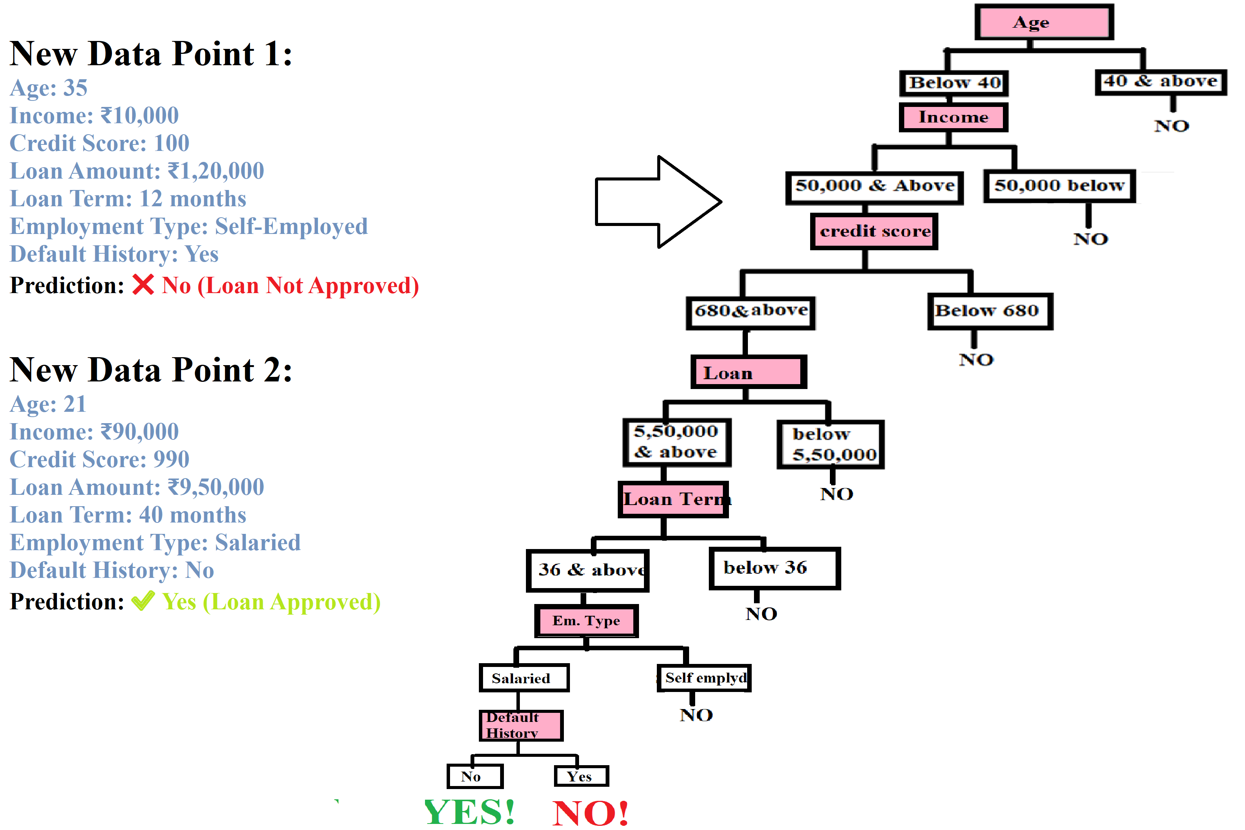

Slide 6
Let's say we have the same dataset as in the example, but with 1,000,000 columns.
Check if the target variable is for classification.
Determine whether the dataset contains both numerical and categorical features.
Read the dataset and check if we can create rules.
If all the above conditions are met, then a Decision Tree is an appropriate choice.
But wait! Is the dataset too large? Does it contain 100,000 rows or more?
If yes, then a Decision Tree may not be the best option, as it is better suited for smaller datasets. In cases where the dataset is too large, we can use an advanced version of the Decision Tree—known as Random Forest.
A single Decision Tree remains a Decision Tree.
Multiple Decision Trees working together form a Random Forest, which is more effective for handling large datasets efficiently.

Slide 7
Real-time scenarios where Decision Trees/Random Forest can be effectively used:
1. Loan Approval in Banks:-A bank wants to decide whether to approve a loan application based on factors such as age, income, credit score, employment status, loan amount, and default history.
Example Decision Tree Rules:
Credit Score > 700 → Loan Approved
Credit Score < 700 & Income > ₹50,000 → Loan Approved
Credit Score < 700 & Income < ₹50,000 & Default History = Yes → Loan Rejected
2. Medical Diagnosis:-A doctor uses a Decision Tree to predict whether a patient has COVID-19 based on symptoms like fever, cough, fatigue, blood test results, and medical history.
Example Decision Tree Rules:
Fever > 100°F & Cough = Yes & Taste Loss = Yes → COVID-19 Positive
Fever < 100°F & Cough = No & Fatigue = No → COVID-19 Negative
Fever > 100°F & Cough = Yes & Taste Loss = No → Flu

Slide 8
3. Fraud Detection in Transactions:- Credit card companies use Decision Trees to detect fraudulent transactions by analyzing customer behavior. A bank wants to identify fraudulent transactions.
Example Decision Tree Rules:
Transaction Amount > ₹1,00,000 & Location = Foreign Country → Fraudulent
Transaction at Unusual Time (3 AM) & New Device → Fraudulent
Transaction Amount < ₹10,000 & Regular Location → Safe Transaction
4. Predicting Student Performance:- A school predicts whether a student will pass or fail based on their study habits.
Example Decision Tree Rules:
Attendance < 50% & Study Hours < 2/day → Fail
Attendance > 80% & Study Hours > 4/day → Pass
Attendance 50-80% & Study Hours 2-4/day → Medium Risk

Slide 9
5. Predicting Car Insurance Claims: Insurance companies use Decision Trees to predict whether a person will file a car insurance claim based on their driving history and vehicle details.
Example Decision Tree Rules:
Driver Age < 25 & Accident History = Yes → High Risk
Driver Age > 40 & No Accidents → Low Risk
Expensive Car & High-Speed Driving Records → Medium Risk
6. Customer Churn Prediction (Telecom Industry):
A telecom company predicts whether a customer will leave (churn) based on their behavior.
Example Decision Tree Rules:
Call Duration < 50 minutes/month & Complaints > 3 → Likely to Churn
Call Duration > 200 minutes & Internet Usage > 10GB → Loyal Customer
Internet Usage < 5GB & Plan Expiry Soon → Medium Risk

Slide 10
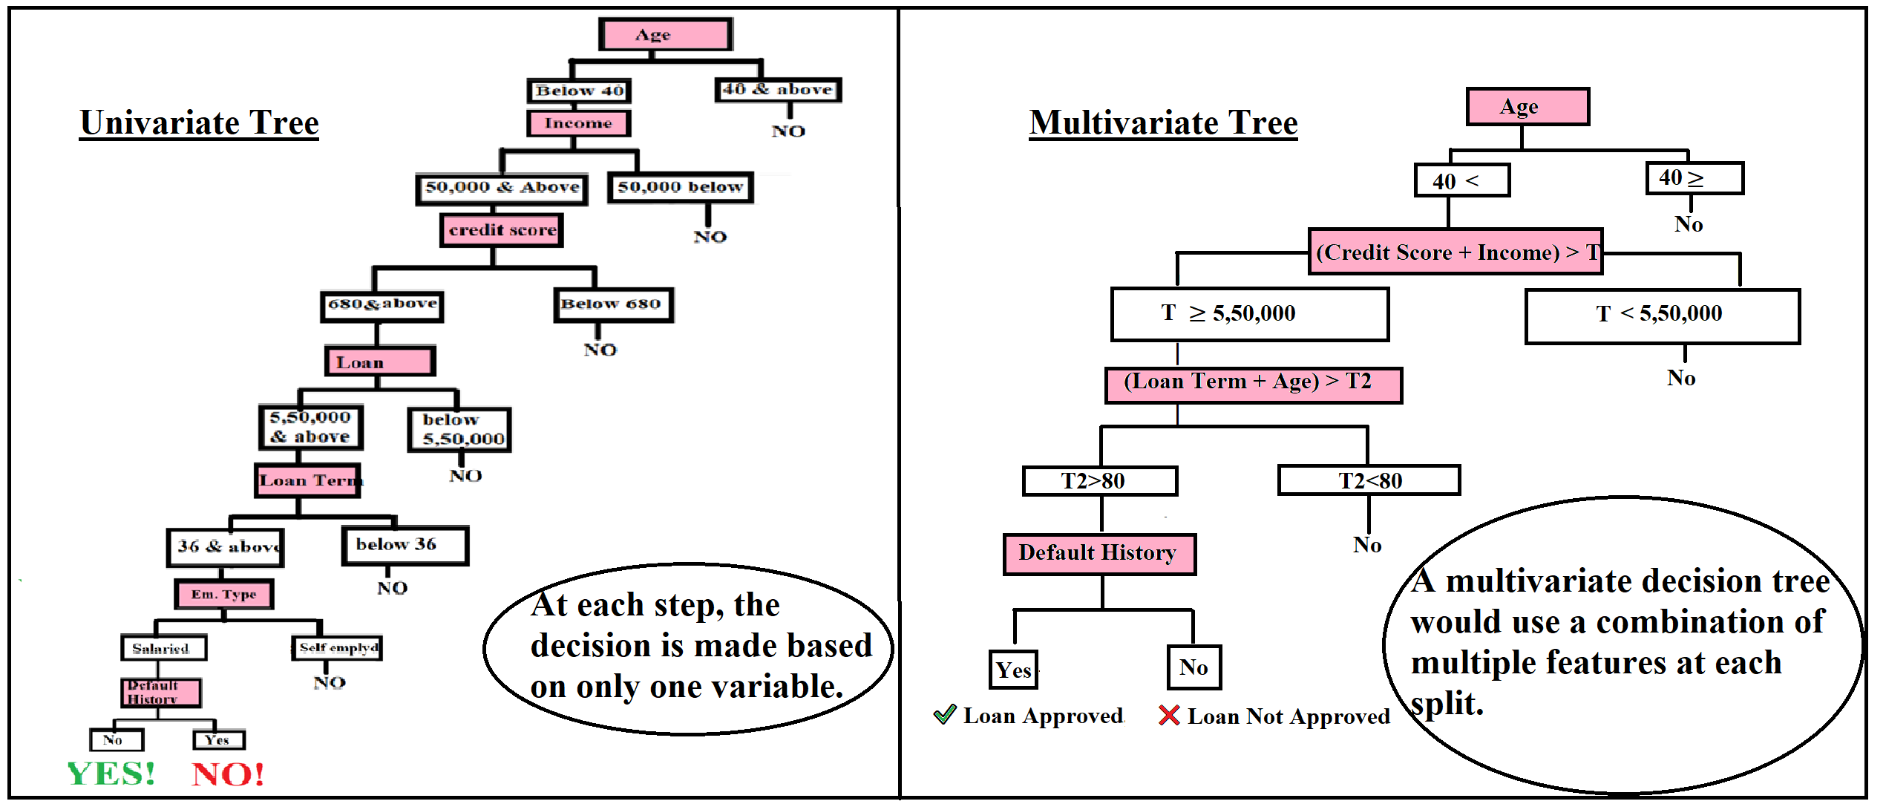
Univariate & Multivariate Decision Tree

Slide 11
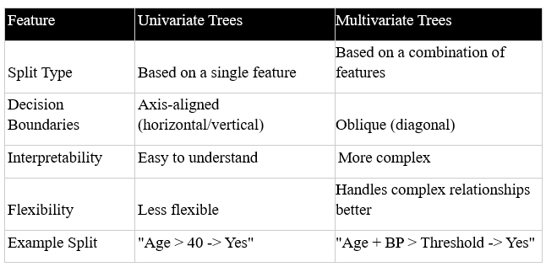
Key Differences in the Image:
Univariate Decision Tree (Left Side)
Each decision node is based on a single feature (e.g., Age, Income, Credit Score).
The splits occur based on individual attributes.
Example: The decision starts with "Age < 40?" and then moves to "Income ≥ 50,000?" followed by "Credit Score ≥ 680?" etc.
Multivariate Decision Tree (Right Side)
Each decision node considers a combination of multiple features.
Uses mathematical conditions like (Credit Score + Income) > T instead of separate splits.
Example: Instead of just checking "Credit Score" and "Income" separately, it checks their combined effect.
Threshold Values (T, T2, T3):
T: A threshold for the sum of Credit Score + Income.
T2: A threshold for Loan Term + Age.
T3: A threshold used for further classification.

Slide 12
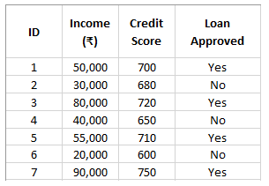
Pruning in Decision Trees
Example of Pruning in Decision Trees
Let's take a simple dataset for loan approval based on income and credit score.

Slide 13
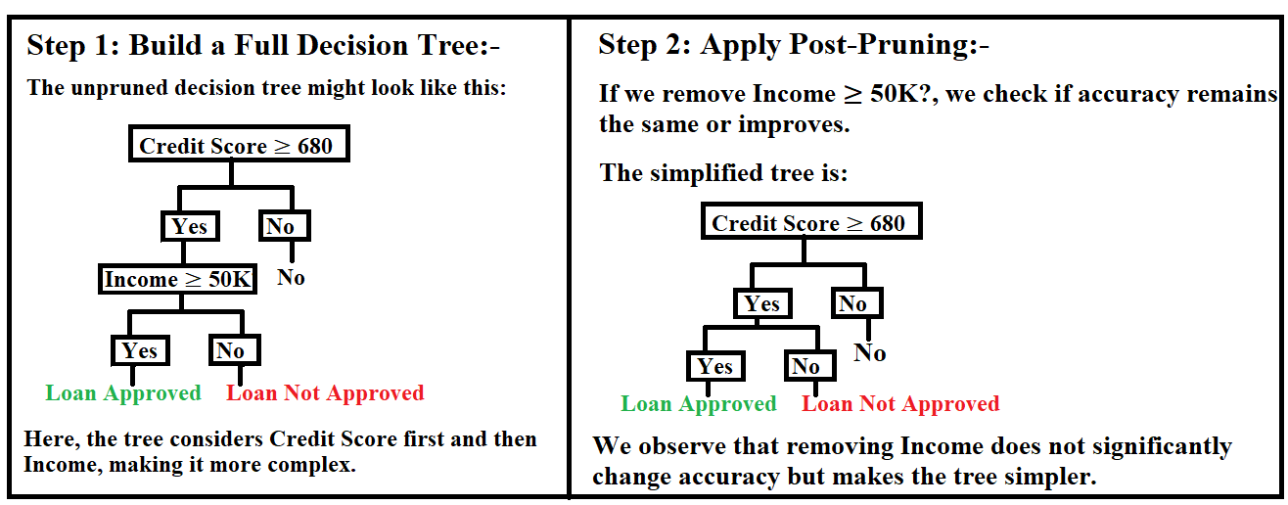
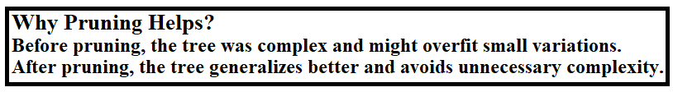

Slide 14
